Slide 1
Topic 3- Specialised cells
Wenting Chai

Slide 2
Specialised cell presentation task
Work in groups
2-3 people in each group
Present to the whole class
Make a ppt to include the information and diagrams
Please practise your presentation within your group 1-2 times before class.
name of cell | Page on textbook
Ciliated cell, goblet cell | 145
Root hair cell | 96-97
Xylem vessel element | 94
Sieve element, companion cell | 95
palisade mesophyll cell | 60
nerve cell | 162
red blood cell | 117
sperm, egg cell | 214
stem cell | 233-234
FYI, xylem vessel element is the type of cell that makes up xylem vessel.
Sieve element and companion cell are the cells that make up phloem tube.

Slide 3

Specialised cell presentation task
Information needed in your presentation:
The name of the cell
A picture of the cell
Where can it be found?
What is its function?
What adaptations does it have? (What structures does it have to allow its function?)
Any other feature you find interesting.
Please do this in your presentation:
Eye contact with the class
Explain any unfamiliar word clearly
Write necessary information on your ppt to aid understanding
Try to talk/ explain your idea using simple words rather than read a long paragraph word by word
Please avoid:
Turning your back to the class while speaking
Put a lot of words on a slide
Pile many unfamiliar/ difficult words without explaining each of them

Slide 4
Specialised cells
Labor division in cells – specialization/ differentiation.
Specialisation
Unspecialised cell
Specialised cell
Same meaning
Differentiation
Undifferentiated cell
Differentiated cell

Slide 5

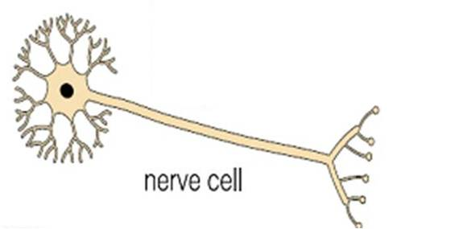
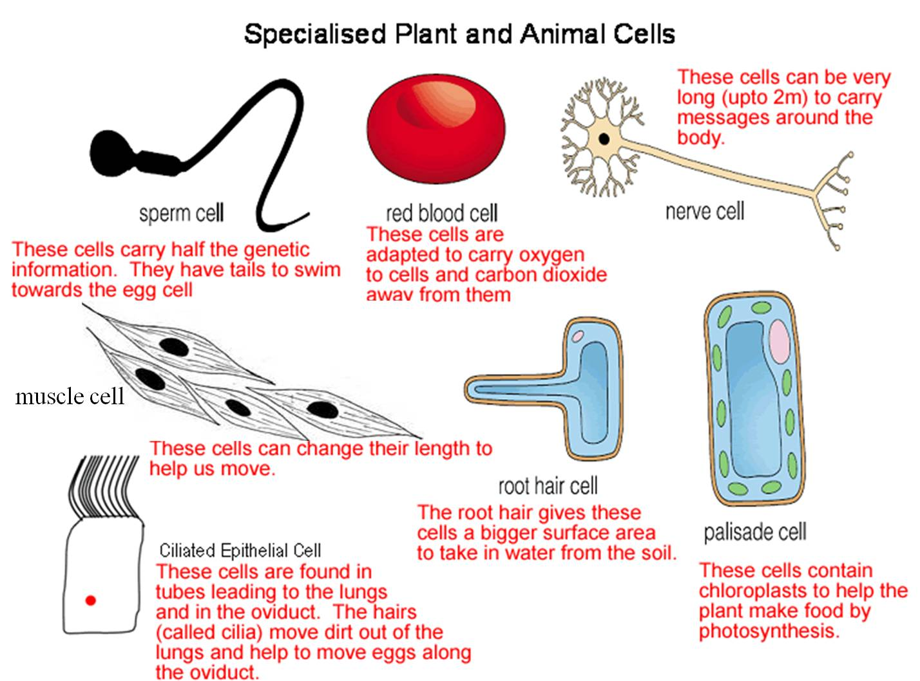
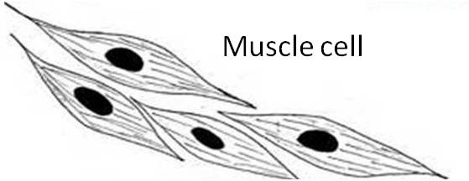
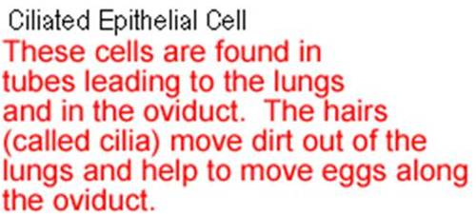
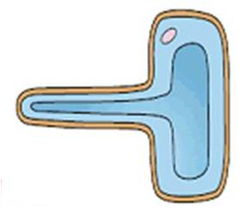
Some specialised cells
These cells can change their length to help us move

Slide 6
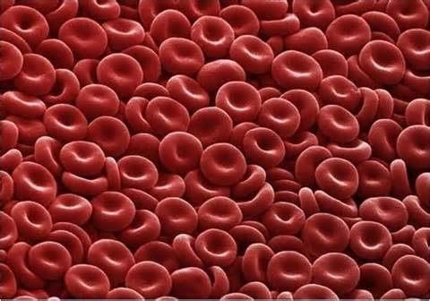
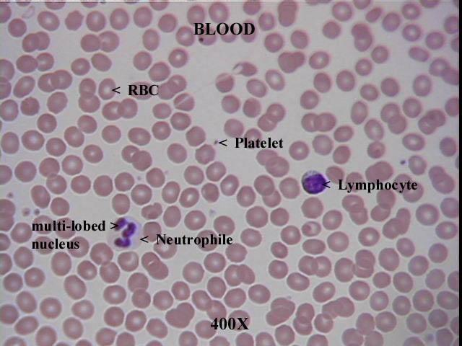
Red blood cell
Adaptations of RBCs:
Biconcave shape increases surface area for more efficient diffusion of oxygen/ gases.
Haemoglobin, the red pigment, to combine/ carry O2.
No nucleus, so more space to pack O2.
Small size, easily be carried in tiny capillaries.
Q: Can you suggest 3 differences between RBC and WBC (lymphocyte & neutrophil)

Slide 7
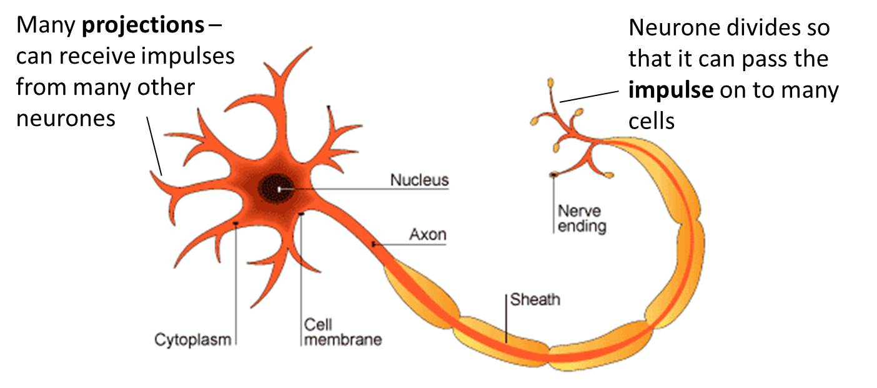
Nerve cell
Adaptations of a neurone:
Dentrites to receive impulses (electric signal).
Long axon enables faster/ more efficient transmission of impulses.
Myelin sheath (surrounding axon) to insulate and enables faster transmission.

Slide 8
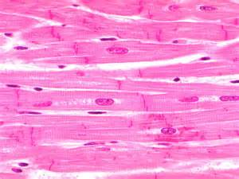
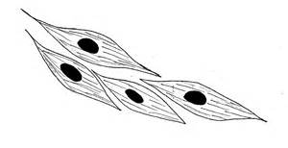
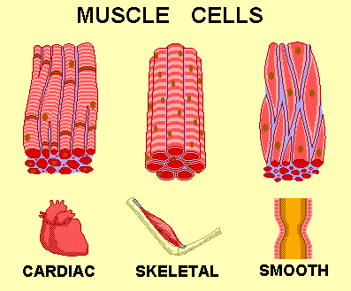
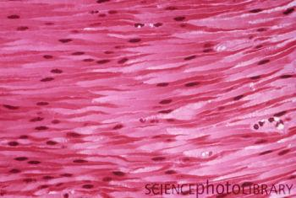
Muscle cell
Can shorten to move bones/ (contract and relax)

Slide 9
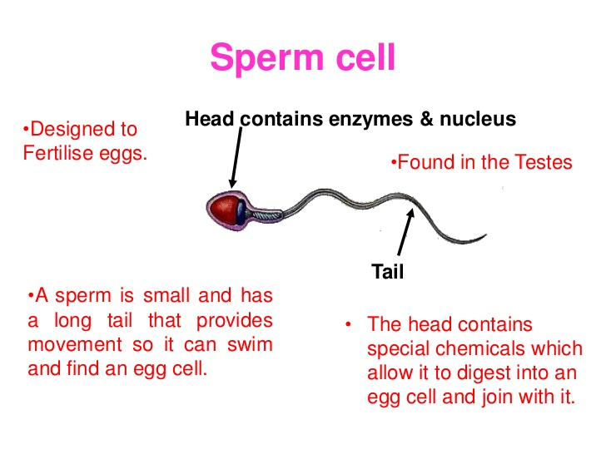

Slide 10
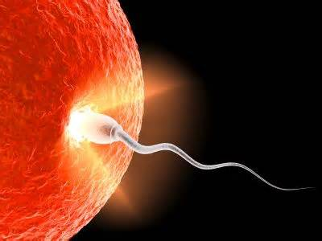
Ova (egg cells) have a store of food (yolk) in the cytoplasm, and is large enough for the sperm to find

Slide 11
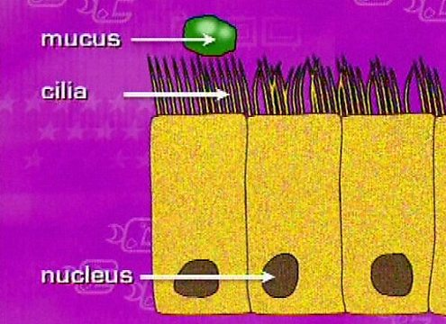
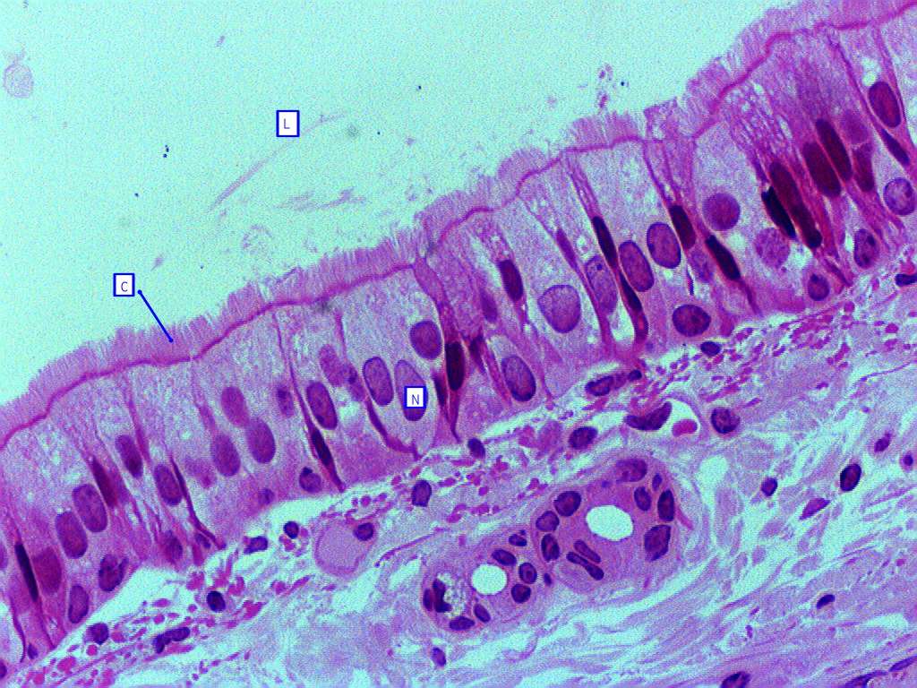
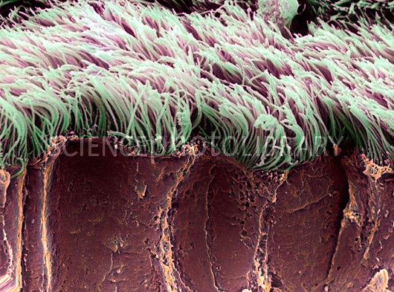
Ciliated cell
Found in trachea and oviduct, have hairs called cilia (thread like projections), aimed to move dirt out of lungs.

Slide 12
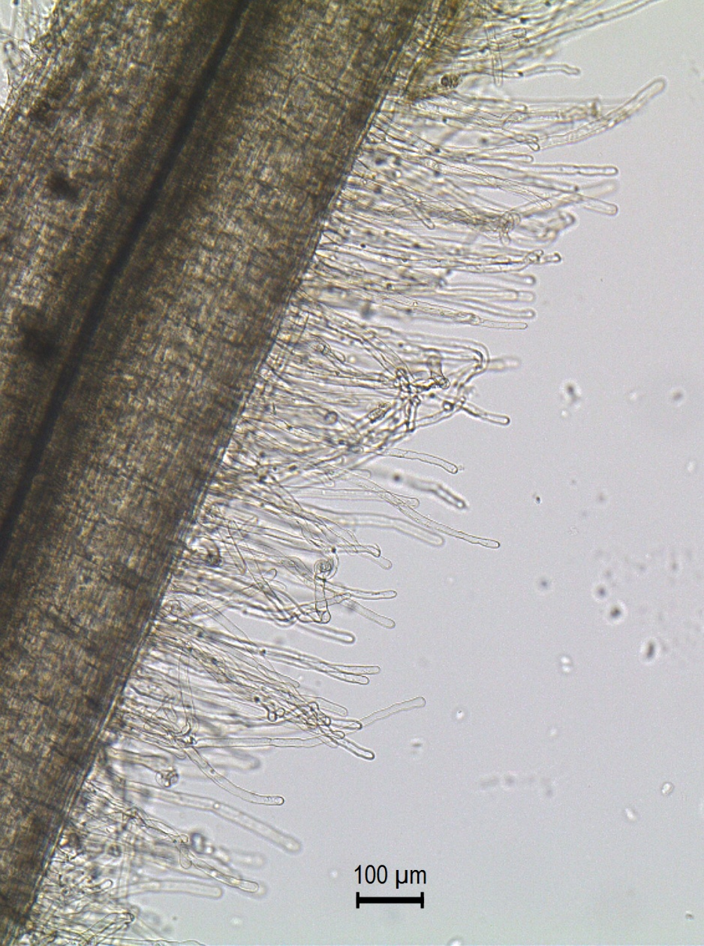
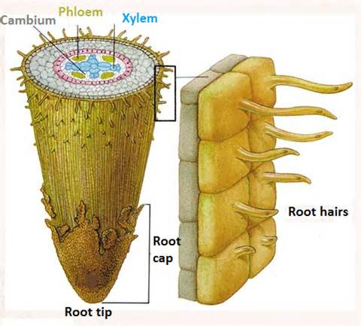
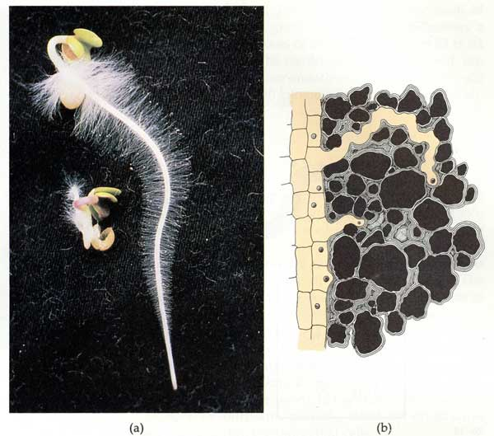
Root hair cells
Long and thin, have large surface area which makes it good at absorbing water from the soil.

Slide 13
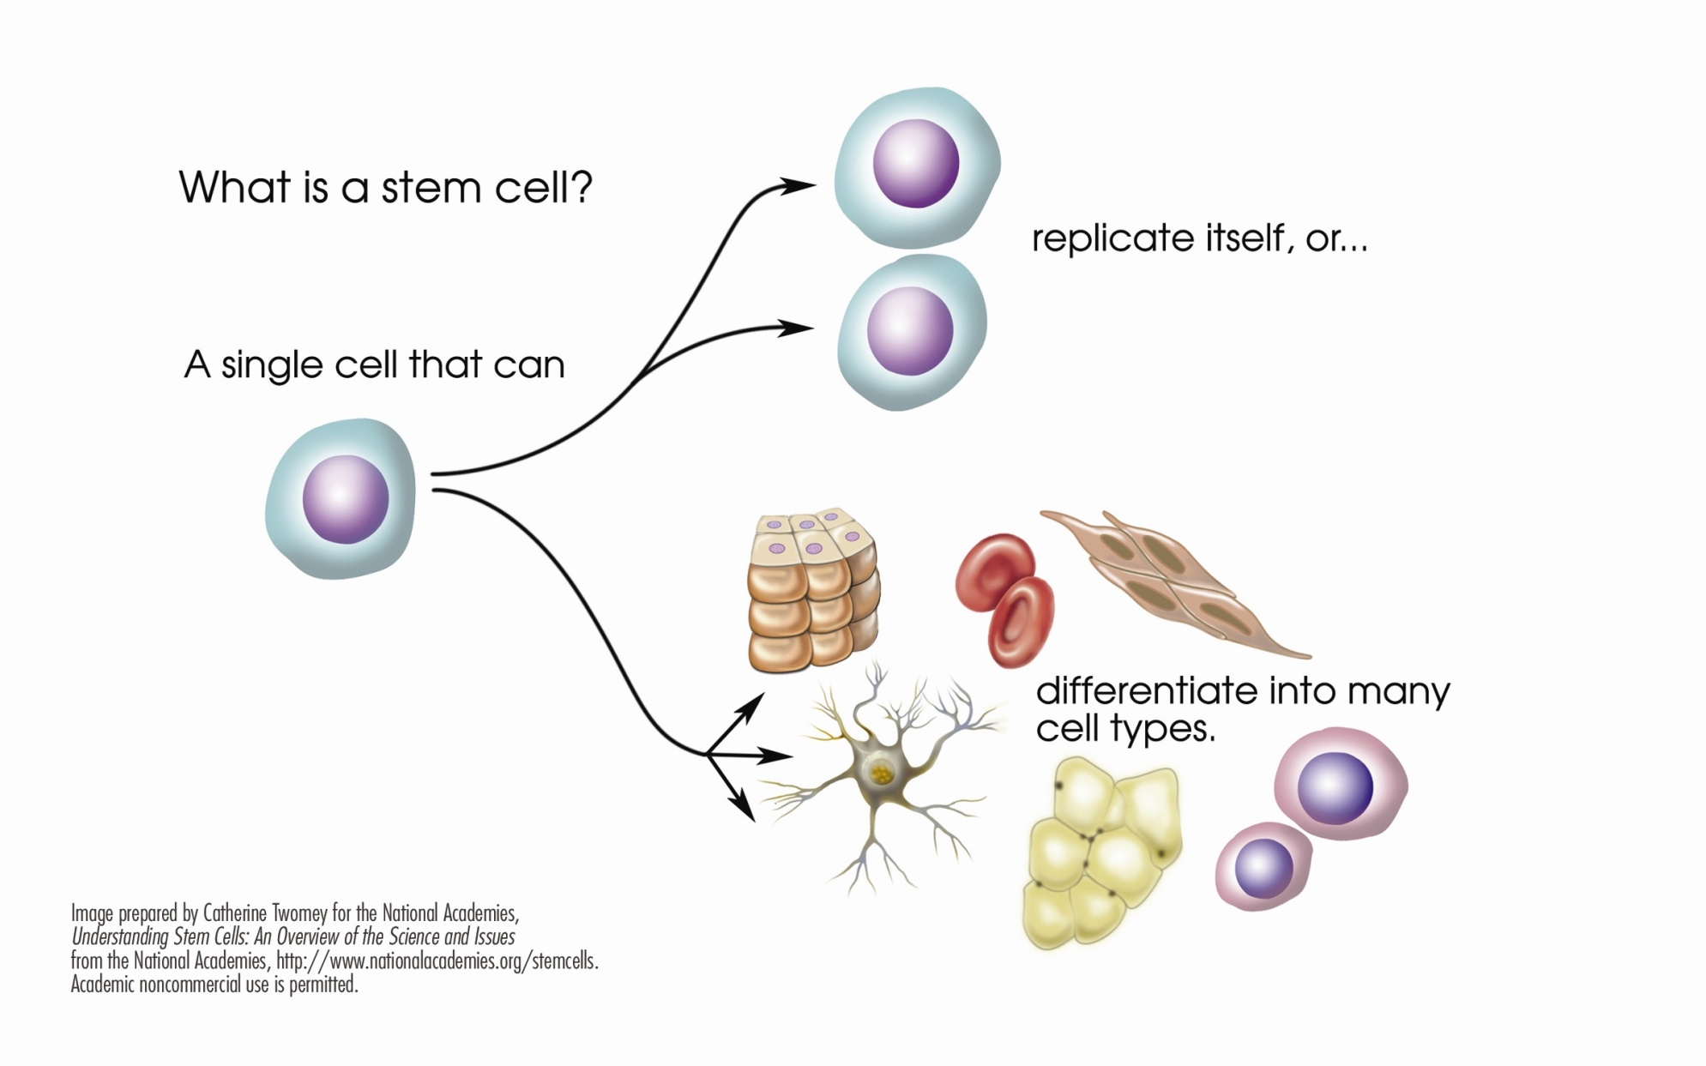
How are these cells formed?

